Slide 1
Social Media Analysis in Disaster Management
AIT -582
Class Project
Spring 2019

Slide 2
Team Members:
Jennifer Le
Miao Zheng
Meenakshi
Sahithi Lakamana

Slide 3
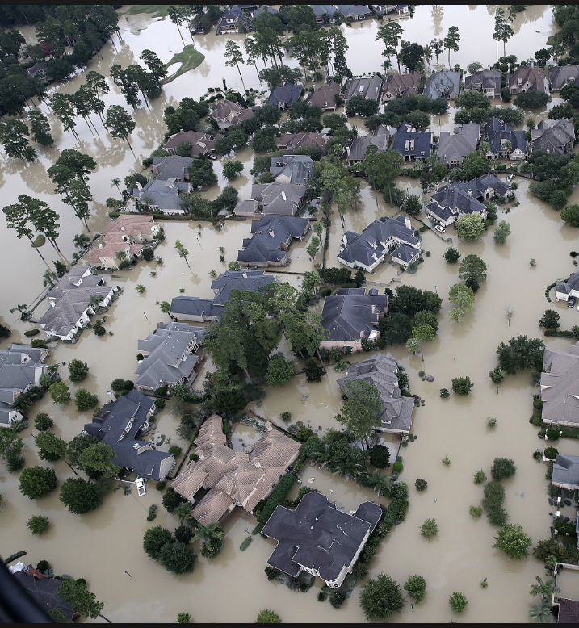
Background and History
Disasters -Hurricane
Hurricane Harvey , Category 4 storm
August 25, 2017, caused $198 billion damage
Triggered flooding in the Houston metropolitan area and Southeast Texas
Social Media - Twitter
How useful social media can be during an emergency?
Can it help you find shelter?
Can help you get first aid or help/get rescued?

Slide 4
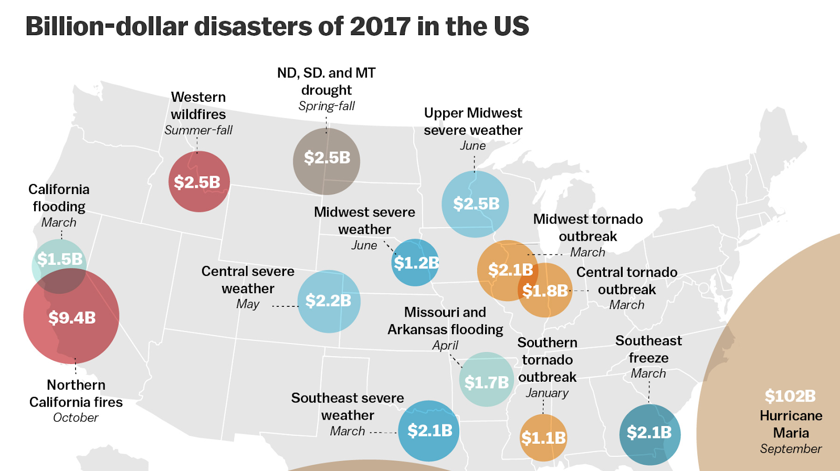

Slide 5
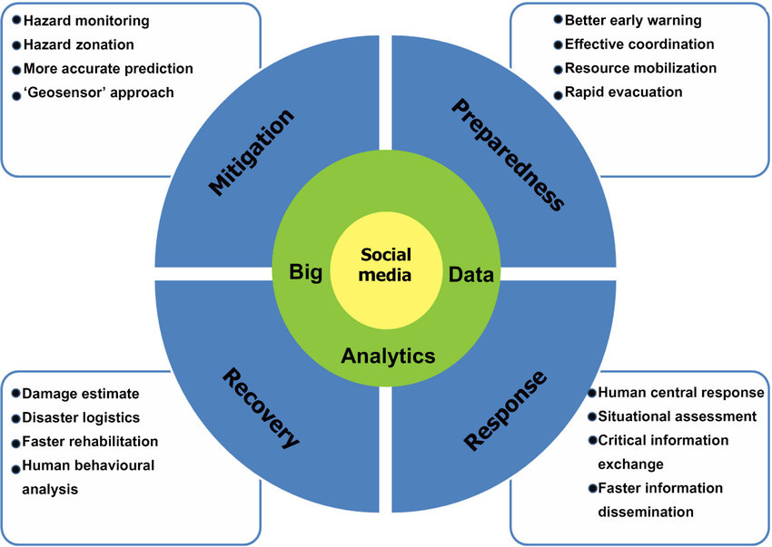
Problem Definition
HOW CAN SOCIAL MEDIA BE HELPFUL IN CASE OF DISASTERS
Volume: millions of tweets
Velocity: Real-time updates
Variety: User-generated data
Notes:
Filter through noisy data (tweets)

Slide 6




Tools Used

Slide 7
DATA SET
Kaggle
Approximately 4 millions of tweets, 20 MB , csv file
Six attributes including Tweets, Likes, Retweets, ID, Time , Replies
University of Texas
46 GB of Json file
Approximately 7 million tweets with more than 130 attributes.
Extracted from Twitter using keywords Harvey, hurricane Harvey
Two files one with Hurricane Harvey Tweets, Other with Tropical Harvey tweets

Slide 8
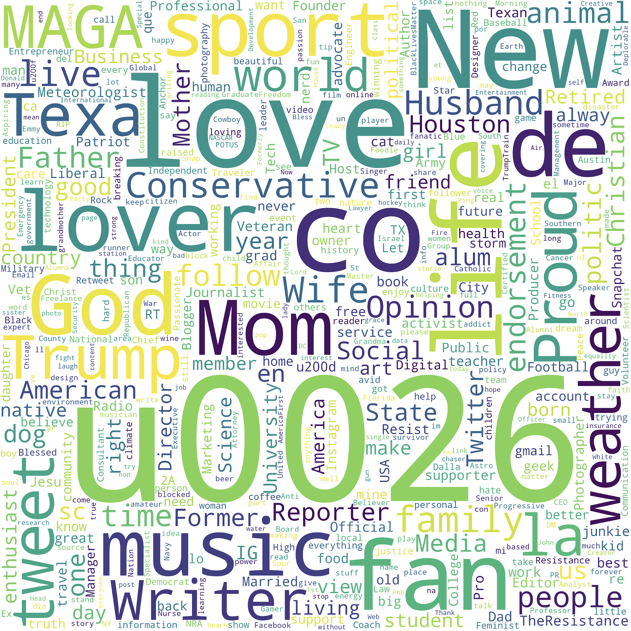
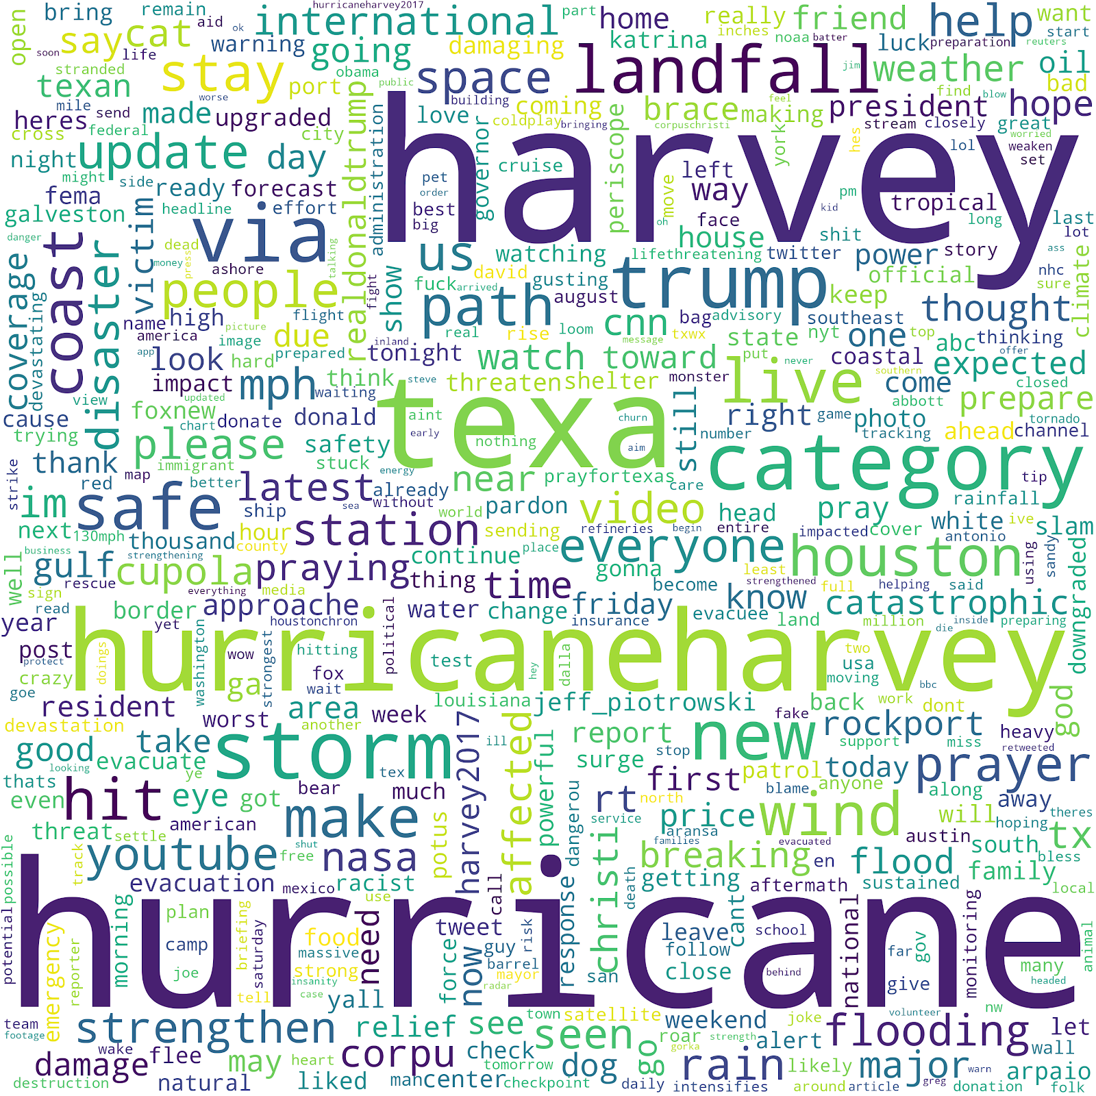
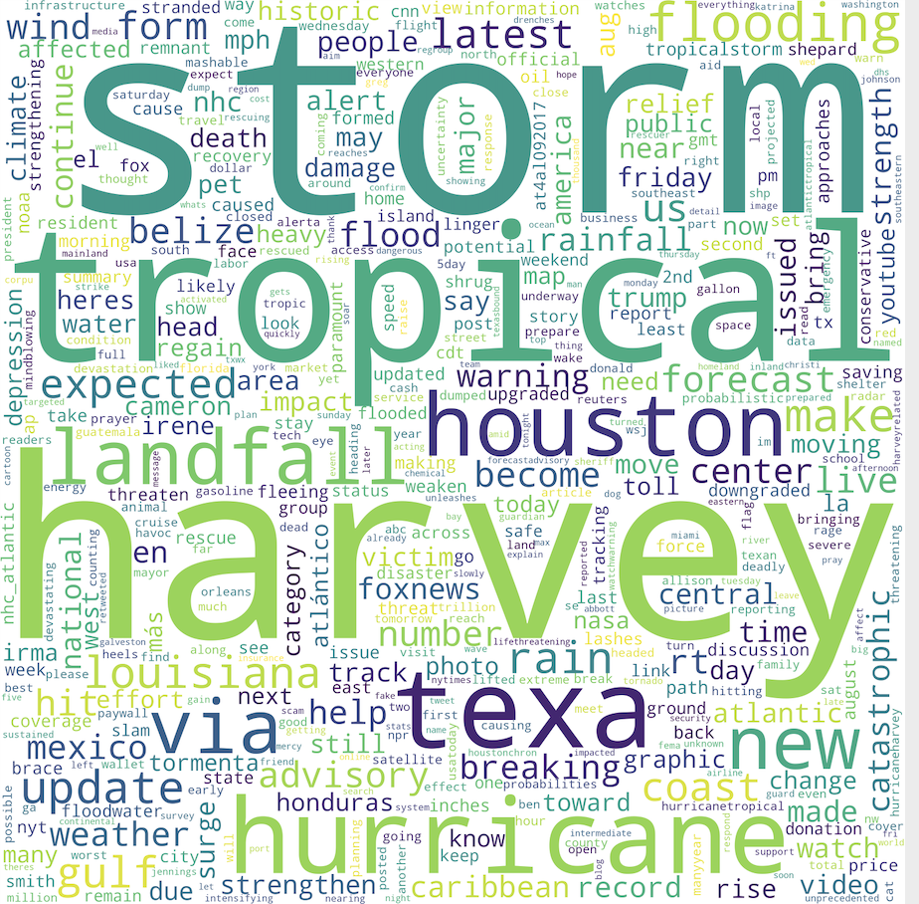
Exploratory Data Analysis
Word Cloud

Slide 9
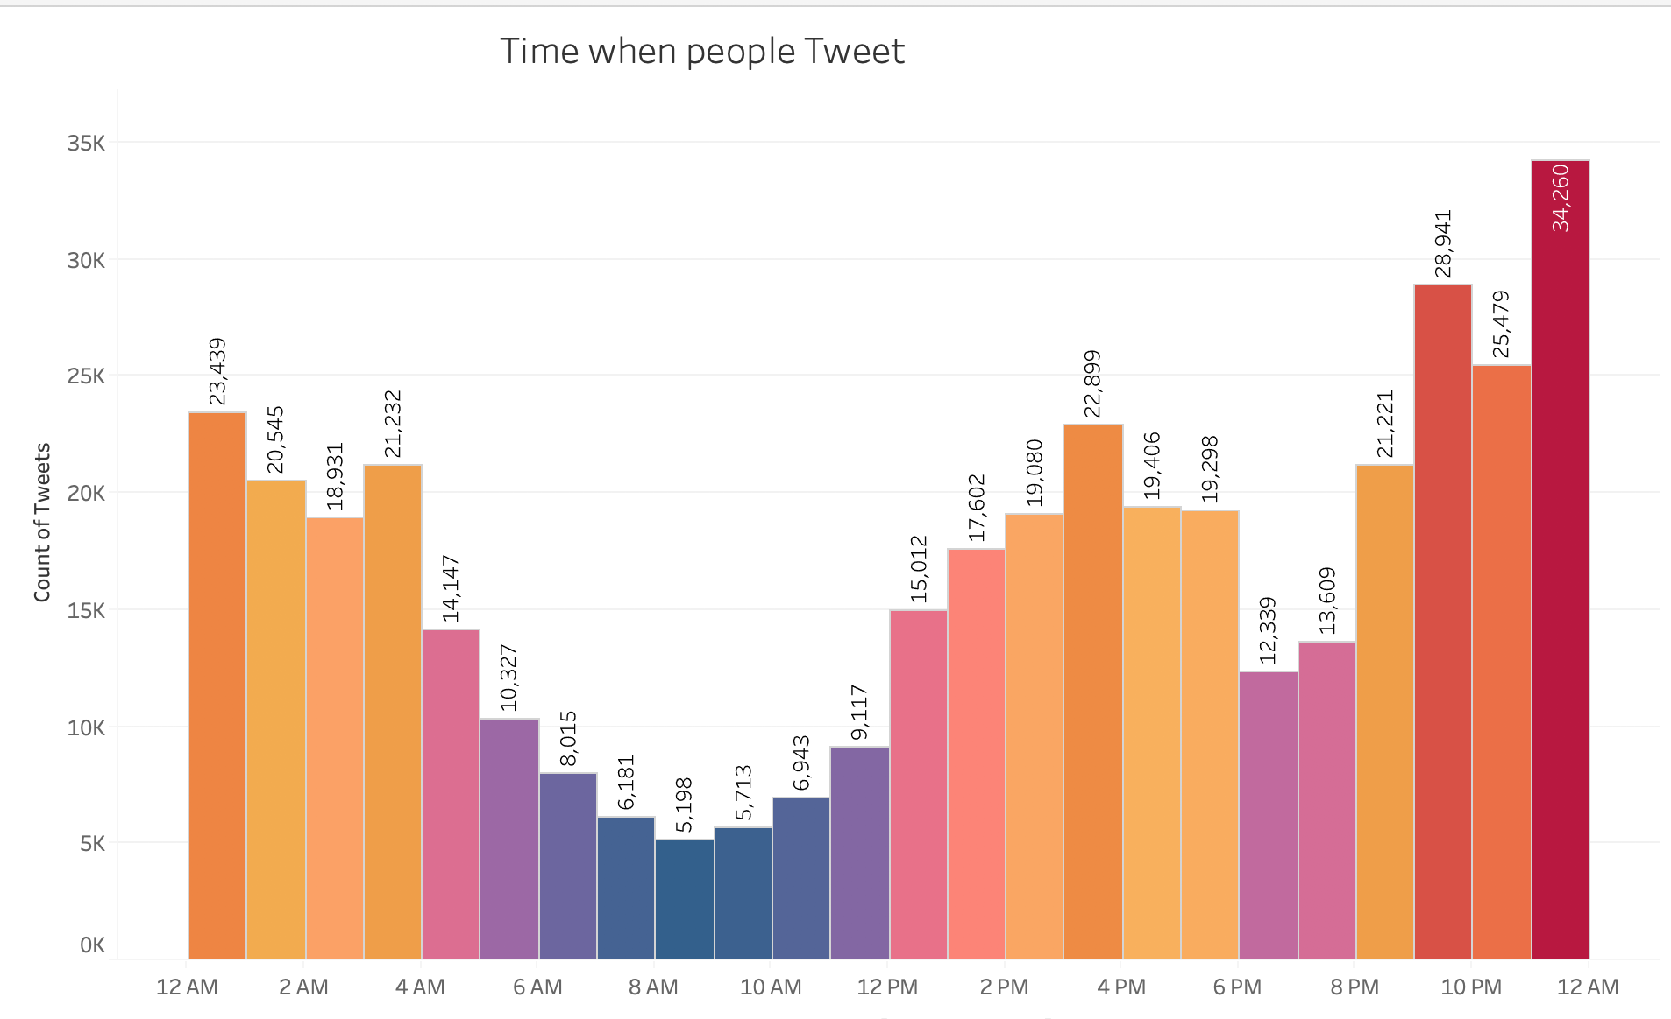
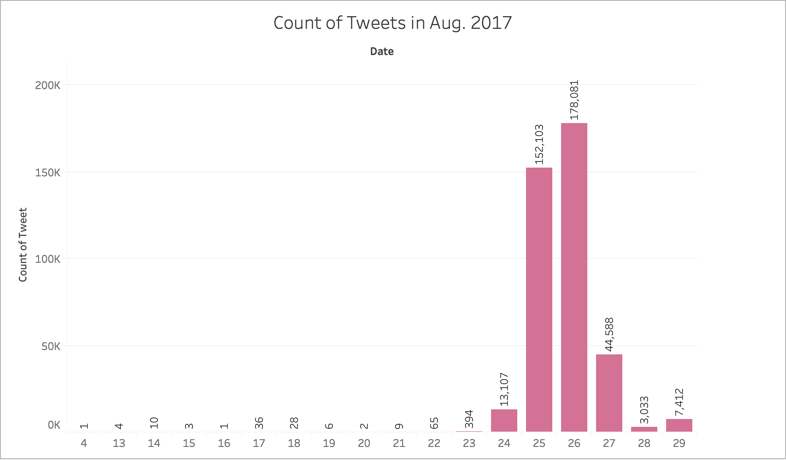
Exploratory Data Analysis

Slide 10
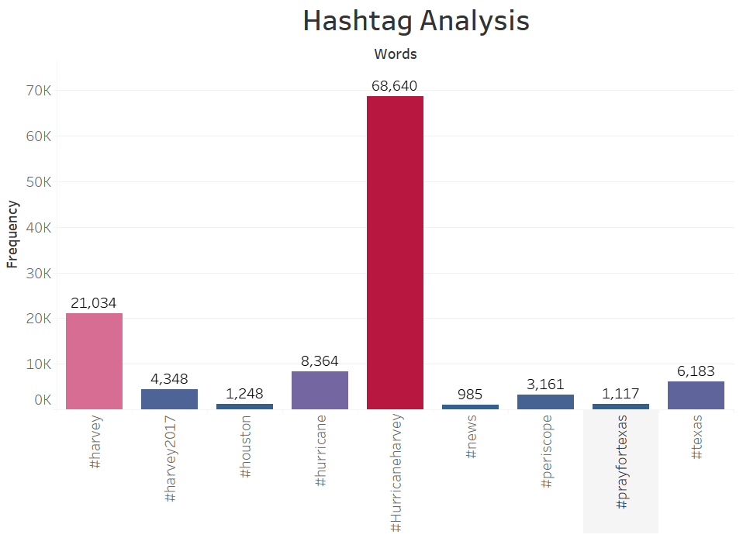
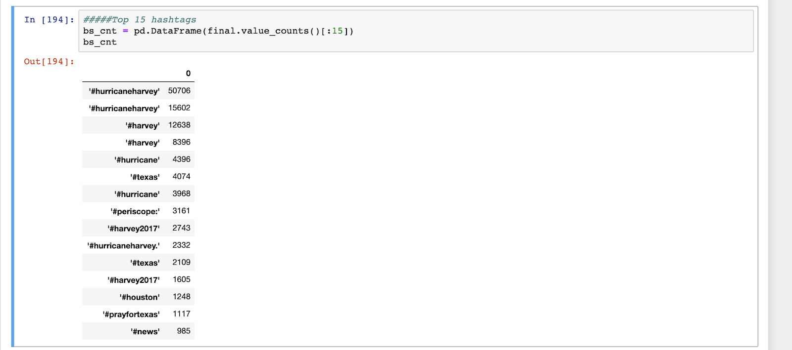
Hashtag Analysis

Slide 11
Data Preprocessing
Tokenization
Stop Word Removal
Removal of punctuations
Lemmatization
Creating Unigrams and Bigrams
Vectorization
A tokenizer divides text into a sequence of tokens, which roughly correspond to "words".
Removing the words like 'a', 'the' which do not contribute to the context
Creating the root form of the words morphologically meaning taking into account the context
Creating the words of group 1 and 2
Converting the words to vectors , for the algorithm's
removing the words 'of', is etc.

Slide 12
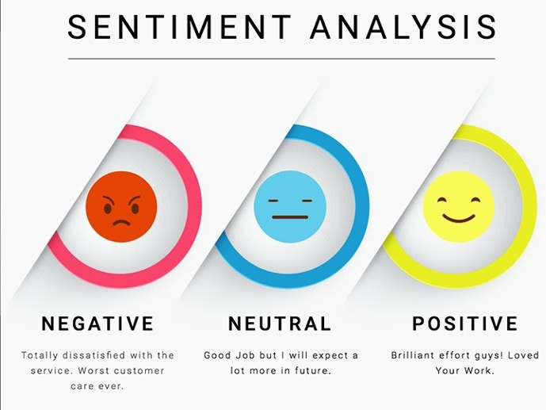
Automated process of understanding an opinion about a given subject from written or spoken language using “Textblob” package.
Many more survivors yet to be rescued
Can be performed better
Evacuation teams were effective,

Slide 13
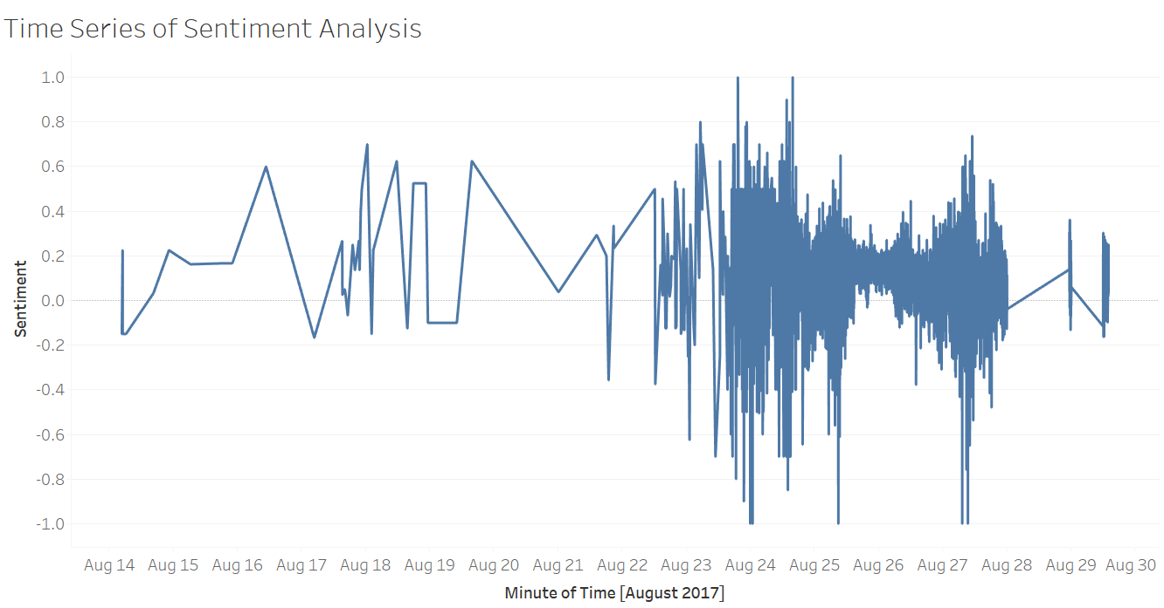
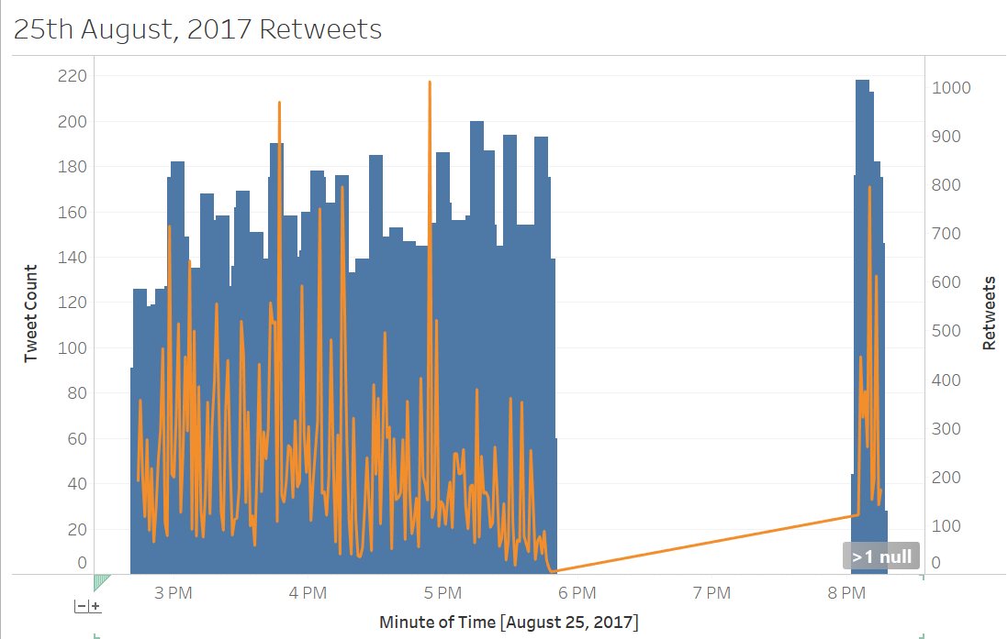
Sentiment Analysis with Time and Day

Slide 14
Clustering
Grouping a set of objects into classes of similar objects
Grouping the text documents into meaningful clusters in an unsupervised manner.
Hypothesis :Relevant documents tend to be more similar to each other than non relevant
Used the K-Means clustering algorithm with k=3

Slide 15
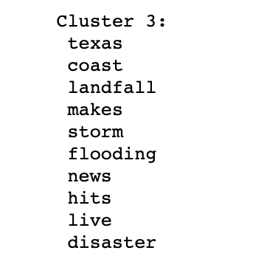
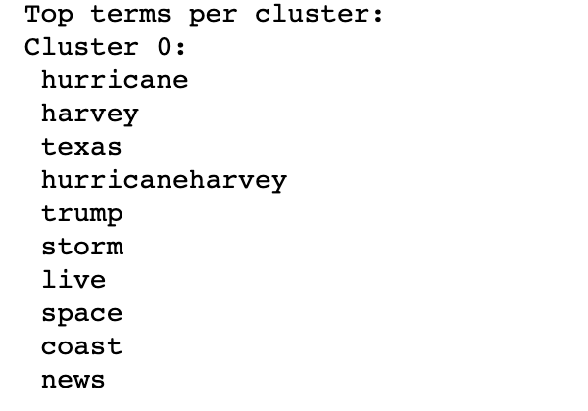
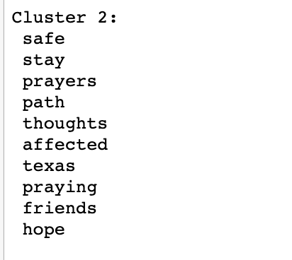
Clustering Results

Slide 16
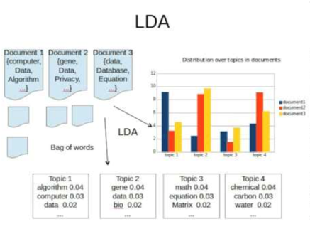
Topic Modelling Latent Dirichlet Allocation
Technique to extract the hidden topics from large volumes of text.
Used Latent Dirichlet Allocation (LDA) from Gensim package (via Gensim).
Known to run faster and gives better topics segregation.

Slide 17
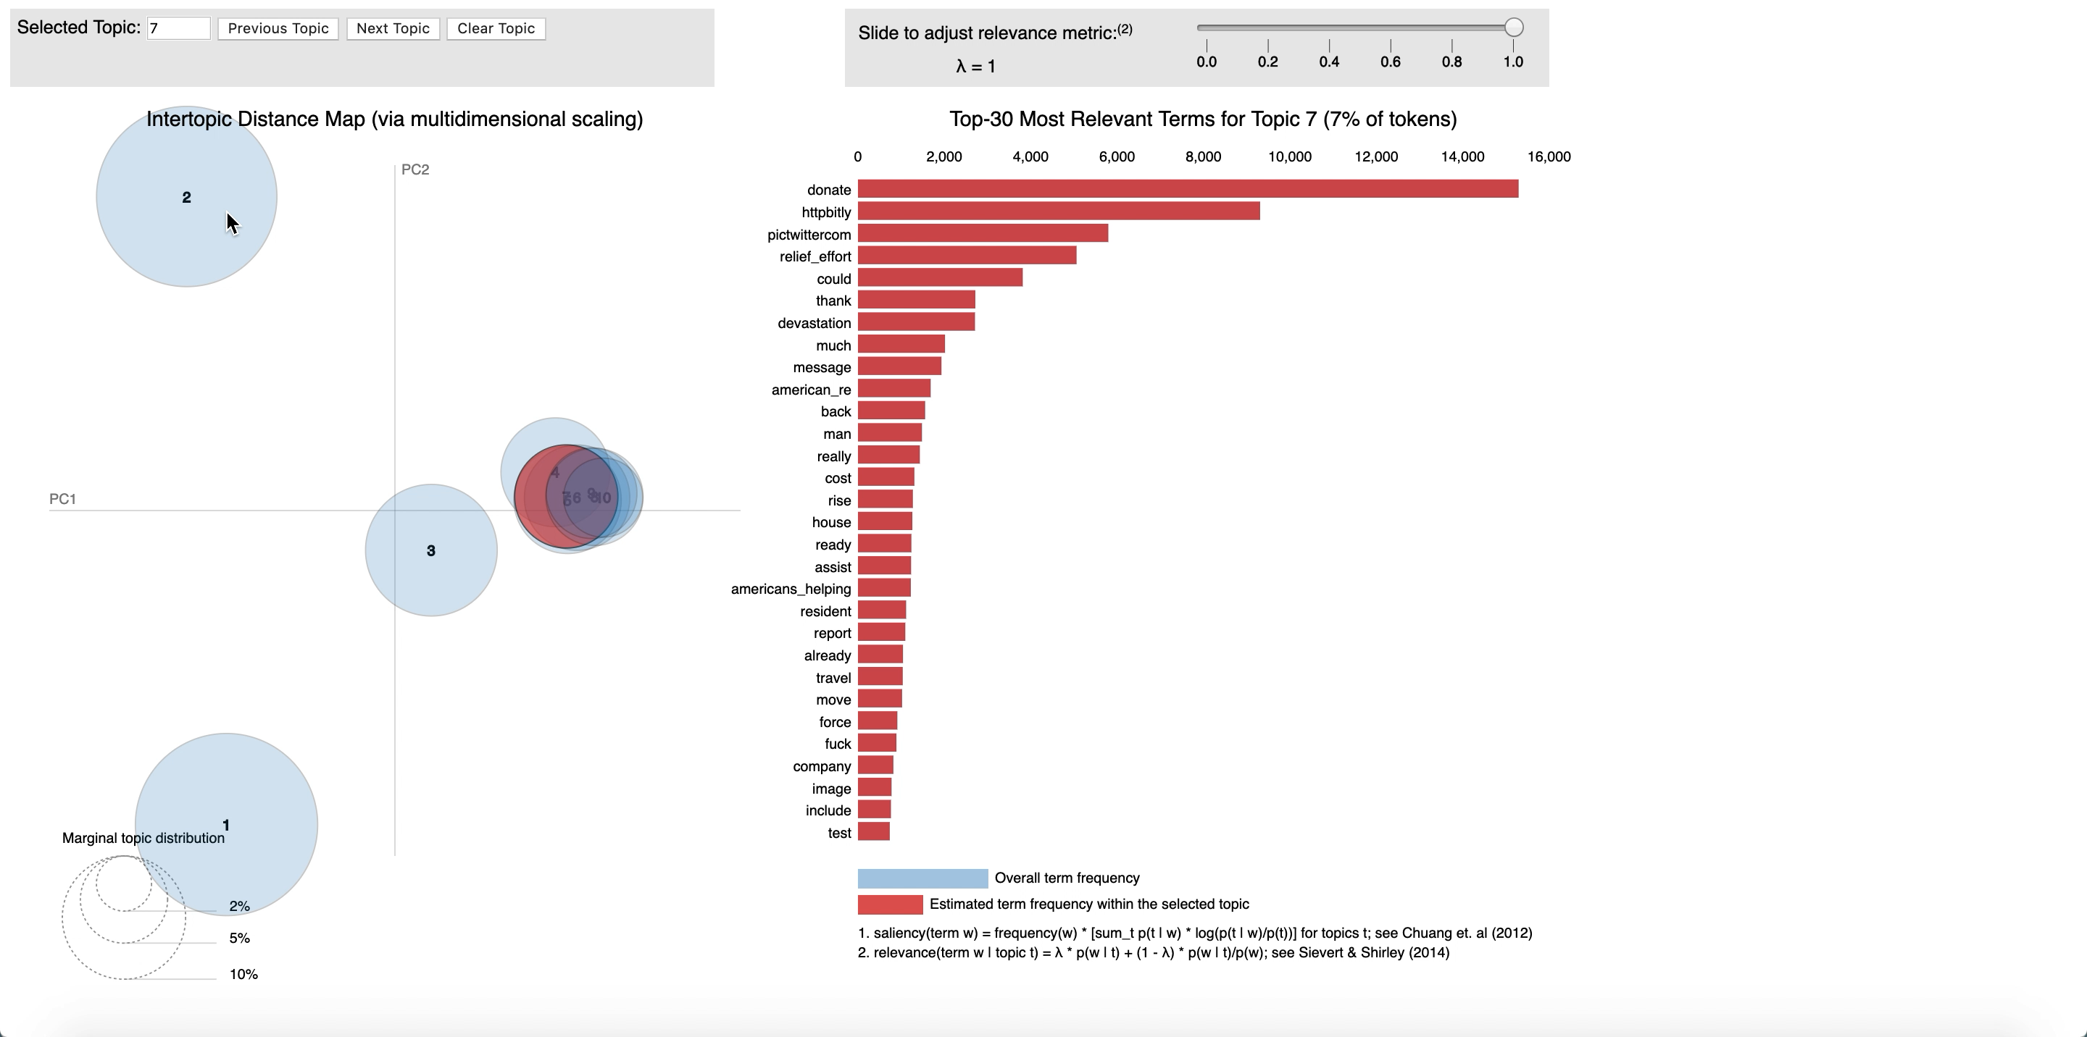
LDA Visualization

Slide 18
Classification of Tweets
Classification of the Tweets into relevant and non relevant information
Relevant information
Volunteers needed
Shelter information
Help needed
General information
Used only a binary classification for the shelter and irrelevant information
Naive Bayes for text classification
Accuracy of around 90%
Hand labelled the data for the relevant and non relevant tweets

Slide 19
Discoveries and Results
Keywords used:
Neutral sentiment
hashtags raising awareness
Twitter activity:
Least tweets in morning hours (8am)
Spikes after 9pm
Hurricane Harvey made landfall approx. 10pm
Supervised learning: Classification Groups
Relevant and irrelevant Information
Accuracy Rate- 90%
Binary classification
Notes:
the hashtags seem to be raising awareness rather than expressing sentiment towards relief efforts or something else

Slide 20
Challenges And Future Scope
45GB JSON dataset containing irrelevant tweets
Less than 10% were hurricane-related tweets
Processing capabilities limited to process large dataset
Kaggle dataset Issues
Missing data for location
Multiple Retweets
User metadata and demographic information
Future Scope
Disaster data in general
University of Texas Dataset Issues
Classification needs more data
Any natural Calamity
Multiclass classification
Geo enabled data can help in finding locations
Real Time Processing
First Responders, Shelters information

Slide 21

Thank You! & Questions

